Slide 1
Air Quality
20 Questions
Virendra Sethi
vsethi@iitb.ac.in
x7809

Slide 2
Guidelines
Use this material as pointers to prepare for the Exam for the Air Quality Module
Use books on Air Pollution to understand the details
If you have questions/need clarifications, please contact me by email vsethi@iitb.ac.in Subject : “ES200 Doubts”

Slide 3
Q 1 : What are the classes of air pollutants ?
How are they managed ?
AMBIENT
  Criteria Pollutants for Ambient Air Quality (used as an indicator of heath of AIR quality)
    Primary : NAAQS
    Secondary : Ozone
INDUSTRIAL
    Emission Factors for Sources for Industrial / Vehicular emissions (Based on per unit product eg CO mg/km travelled)
    Used to develop an inventory of all air pollutants from various category of sources in an area of interest
    Compliance and use of Best Available Control Technology (BACT) at time of installation and periodic upgradation as required
MoEFCC > CPCB > SPCB
MoEFCC : Ministry of Environment, Forests and Climate Change
CPCB : Central Pollution Control Board
SPCB : State Pollution Control Boards.

Slide 4
Q2 : How is the effect of a source estimated in the ambient ?
Dispersion (Gaussian Plume Model) – Ground Level Concentrations (GLC)
  Meteorological conditions
    Temperature Profiles (atmospheric stability)
    Wind Conditions
  Source Strength
  Stack height
WIND

Slide 5
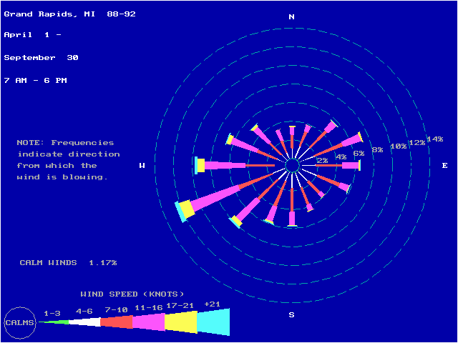
Q3 : What is a Wind Rose ?
Graphical representation of wind (a) direction, (b) speed and (c) frequency.
Starting point for planning for approval for set-up of new industry. Used for Environmental Impact Assessment (EIA) prior to getting permission to install.
1 knot = 1.82 km/hr
http://www.epa.gov/ttn/naaqs/ozone/areas/wind.htm#dlfi

Slide 6
Q4 : What are Lapse Rates ?
Atmosphere cools with height
  What rate ?
    Adiabatic Lapse Rate (ALR) (Dry) 10°C/km
        (Wet) 6°C/km
      (Wet is lesser because of release of heat with condensation)
    Environmental Lapse Rate (ELR) is the ACTUAL vertical temperature profile (as measured, for example, by using a weather balloon)

Slide 7
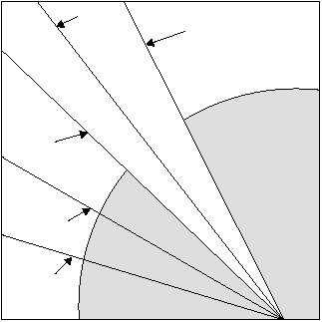
Q5 : What is Atmospheric Stability?
Average
Wet Lapse Rate
Dry Lapse Rate
Stable
Unstable
http://www.tpub.com/content/aerographer/14312/css/14312_47.htm

Slide 8
Q6 : If the parcel of air (as shown) were lifted, would it continue to rise ?
1100 m
20 °C Air Parcel
1000 m (say)
ADIABATIC (1°C/100 m)
ACTUAL
20 °C

Slide 9
Q7 : What are the removal mechanisms for larger/smaller particles in the atmosphere ?
Inertia/Gravity
DIffusion
COLLECTION / REMOVAL EFFICIENCY
0.01
1.0
100
PARTICLE DIAMETER (μm)

Slide 10
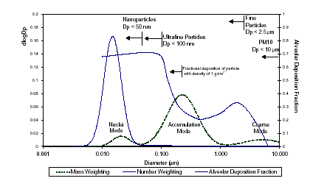
Q8 : What are the three plots in this graph ? What are the likely sources of the three modes?
Factional deposition of
particles with sp gr = 1
(Source: Kittelson et al. 1999)

Slide 11
Q8-Answers
3 plots :
  (a) Mass distribution function
  (b) Number distribution function
  (c) Alveolar deposition efficiency
3 Modes
  Nucleation (nucleation, chemical reactions)
  Accumulation (coagulation of smaller particles, particles, condensation of vapour on small particles, secondary aerosols)
  Coarse (dust entrainment)

Slide 12
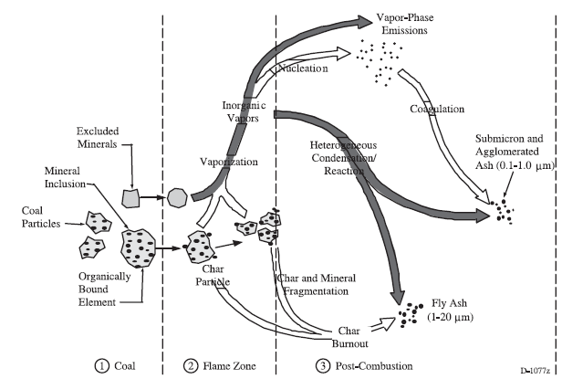
Q9 : What are the possible pathways for the formation of particles in different modes ?
NUCLEATION MODE
ACCUMULATION MODE
COARSE MODE
Example : Particle formation in coal combustion
Source: Flagan and Seinfeld, 1988

Slide 13
Q10 : How would you size aerosol particles smaller than 1 μm?
Optical Microscopes (limited to 0.1μm by λ)
Cascade Impactors (0.056 to 18 μm)
Optical Particle Counters (0.09 μm)
Electrical Mobility + Condensation Particle Counters (0.003 μm)
Electron Microscopy

Slide 14
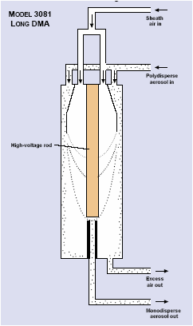
Q11 : How is the Electrical Mobility Principle used ?
Differential Mobility Analyser (DMA)
Particles with Boltzman charge distribution is introduced in an annular electrical field. Particles of a certain size (having a certain charge) follow a specific trajectory.
Only particles in a narrow size range “hit” the target window.
The electrical field is then changed and a different particle size-charge can then hit the target window.
The electrical field is thus scanned up and down to cover the intended size range.
This DMA allows size separation using electrical mobility
Particles in a narrow size range go to a CPC for being counted
Source : TSI Inc.

Slide 15
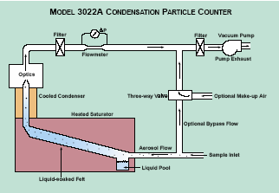
Q12 : How does the Condensation Particle Counter work ?
Source : TSI Inc.
SAMPLE FROM DMA
Particles “sized” by DMA are made to grow in size by condensation of alcohol vapour, and then detected in CPC using light scattering

Slide 16
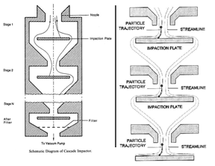
Sample In
Q13 : How does a Cascade Impactor work ?
NOZZLE
Impaction Stages
Principle : Particle inertia
Nozzle diameter gets progressively smaller and smaller, and smaller particles gain inertia to then impact out at lower stages.
Filter (to capture the smallest particles that could not impact on upper stages)
To Vacuum Pump

Slide 17
Q14 (a) : What is PM₁₀ ? What is PM_{2.5} ?
Particles smaller than 10 μm are inhalable (respirable)
  (Particles greater than 10 μm get stopped in the nasal passage).
Total Mass concentration of particles in air that are smaller than
10 μm is PM₁₀ ( units are μg/m³)
Anthropogenic sources (combustion/industry/vehicles) emit particles predominantly in the ~ 2.5 μm size range. PM_{2.5} is the mass of particles smaller than 2.5 μm, and is a measure of anthropogenic sources (greater health concern as these may be more toxic)
Q14(b) : What could be the difference in the size distribution of ambient particles at a road crossing in peak traffic hour and a rural site in Thar desert ?
The relative mass fraction of PM_{2.5} for the traffic crossing site is more (Vehicular emissions vs. Sand particles in Thar).

Slide 18
Q15(a) : What are the control measures for particulate pollutants ?
        PRINCIPLE
Settling Chambers Gravity
Cyclones Inertia
Scrubbers Physical contact with liquids
Electrostatic Precipitators Electrical Mobility
Filters Interception/Impaction/Diffusion
Q15(b) : What are the control measures for gaseous pollutants ?
        PRINCIPLE
Absorption (Scrubbers) Affinity in liquid
Adsorption Affinity at solid surface
Incineration Burning it to CO2 + Water
Membrane separation

Slide 19
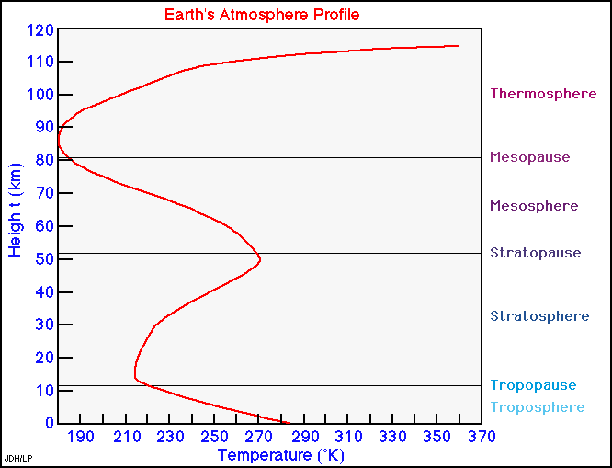
Q16: What is the structure of Earth’s atmosphere ?
Ionosphere
■ Low Vertical Mixing
■ Ozone (Energy Absorption)
■ 80% of total mass

Slide 20
Q17 : What is the difference in the incoming and outgoing radiation on earth ?
How do the presence of different gases/vapours influence the radiation balance ?

Slide 21
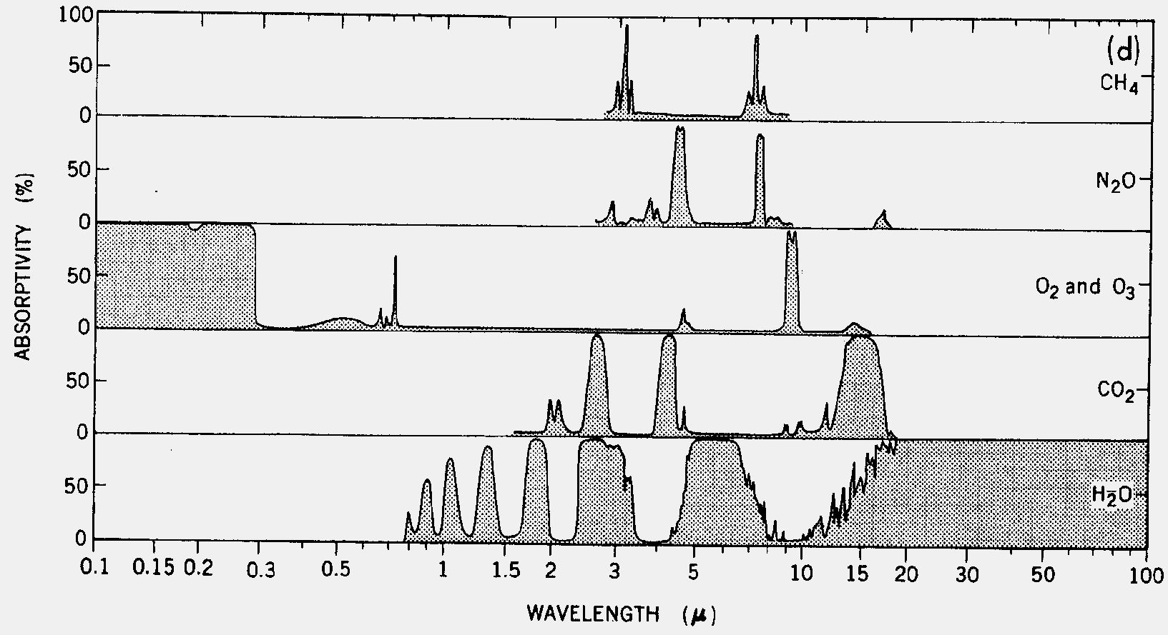
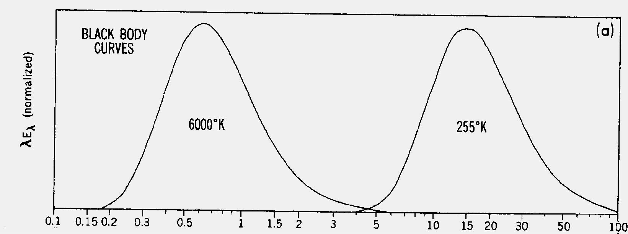
CH₄
Absorption: Individual Gases
Q :17
N₂O
O₃, O₂
CO₂
H₂O
solar
terrestrial
Peixoto and Oort: Physics of Climate

Slide 22
Q 18 : What is the Relative Global Warming Potential (GWP) for different greenhouse gases ?
Gas* | Lifetime | GWP (20 Years) | GWP (100 Years)
CO₂ |  | 1 | 1
CH₄ | 12.2 | 56 | 21
CFC-11 | 50 | 5000 | 4000
N₂O | 120 | 290 | 320
This list of gases is a small subset of all the greenhouse gases and serve only as examples Ref : Adapted from Masters (1995)

Slide 23
Q 19 : What is Albedo ? If the albedo changed to 0.30, how would it affect the Earth’s temperature ?
Albedo is the ratio of the reflected radiation to the incident radiation.
SIMPLE RADIATION BALANCE
Solar Energy Striking Earth = S(1-α) .πR²
  S = solar constant (1370 W/m²)
  α = 0.31 (Current estimate of Albedo)
Energy radiated back to Space by earth
= σ 4 π R² T_{e}⁴ (σ = 5.67Ε−8 W/m²−Κ⁴ )
Equating
  T_{e} = [ S(1-α)/(4 σ)]^{1/4} = 255 K (-18°C)

Slide 24
Q 20
What are your action points as a
District Collector for controlling air pollution in your city ?

Slide 25
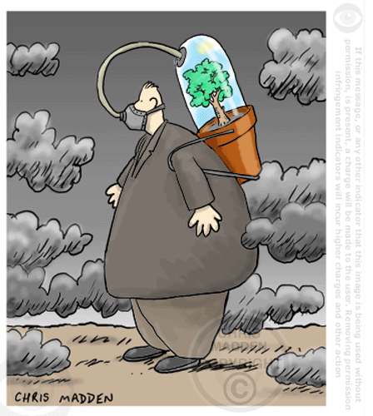

Fun Question : How many trees per person ?

Slide 26
Thank You
For your participation
and
for listening committedly.
I request you to keep reading (an hour a week) and keep yourself updated on Environmental Issues.
Always available at
vsethi@iitb.ac.in
Have a Great Life !

